Slide 1
UML: introduction
Unified Modeling Language (UML) makes it possible to describe systems with words and pictures.
UML was standardized by Object Management Group (OMG) — http://www.omg.org, an international association that promotes open standards for object-oriented applications.
https://sourcemaking.com/uml/introduction

Slide 2
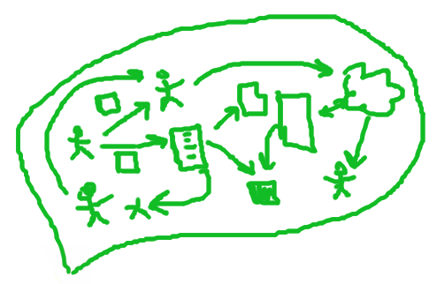


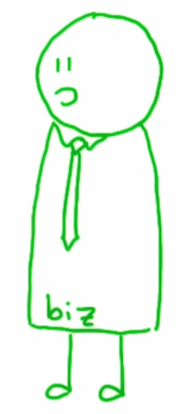
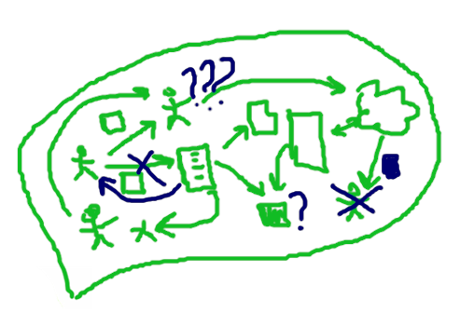
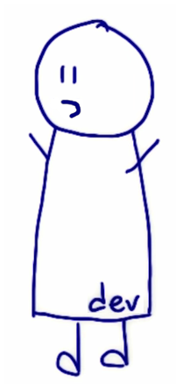
UML. Why we need it?
???
zZzz
We need:
universal symbol notation
universal notation not tied to specific technologies
notation should be verified on real projects

Slide 3
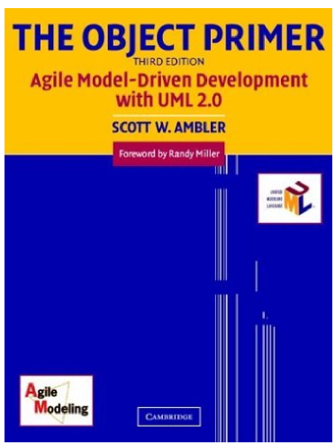
Modelling and the UML
Scott W. Ambler, The Object Primer. Agile Model-Driven Development with UML 2.0, Cambridge University

Slide 4
Overview of Object-Oriented Concepts
Term | Description
Abstract class | A class that does not have objects instantiated from it
Abstraction | The essential characteristics of an item (perhaps a class or operation)
Aggregation | Relationships between two classes or components defined as «is part of»
Aggregation hierarchy | A set of classes related through aggregation
Association | A relationship between two classes or objects
Attribute | Something a class knows (data/information)
Cardinality | The concept of «how many?»
Class | A software abstraction of similar objects, a template from which objects are created
Classifier | A UML term that refers to a collection of instances that have something in common That includes classes, components, data types, and use cases.
Cohesion | The degree of relatedness of an encapsulated unit (such as a component or a class)
Collaboration | Classes work together (collaborate) to fulfill their responsibilities
... | ...
Scott W. Ambler, The Object Primer. Agile Model-Driven Development with UML 2.0, Cambridge University

Slide 5
4 basic Object-Oriented concepts
Term | Description
Class | A class is a software abstraction of an object, effectively, a template from which objects are created
Object | An object is a software construct that mirrors a concept in the real world, e.g. a person, place, thing.
Attribute | An attribute is equivalent to a data element in a record.
Method | A method can be thought of as either a function or procedure. Methods access and modify the attributes of an object.

Slide 6
Diagram Groups of UML 2
Behavior diagrams. This is a type of diagram that depicts behavioral features of a system or business process. This include activity, state machine, use case, and interaction diagrams.
Interaction diagrams. This is a subset of behavior diagrams that emphasize object interactions. This includes communication, interaction overview, sequence, and timing diagrams.
Structure diagrams. This is a type of diagram that depicts the static elements of a specification that are irrespective of time. This includes class, composite structure, component, deployment, object, and package diagrams.

Slide 7
The diagrams of UML 2 (1/2)
Diagram | Description
Activity diagram | Depicts high-level business processes, including data flow, or to model the complex logic within a system.
Class diagram | Shows a collection of static model elements such as classes and types, their contents, and their relationships.
Communication diagram | Shows instances of classes, their interrelationships, and the message flow between them, and typically focuses on the structural organization of objects that send and receive messages.
Component diagram | Depicts the components, including their interrelationships, interactions, and public interfaces, that compose an application, system, or enterprise.
Composite structure diagram | Depicts internal structure of a classifier (such as a class, component, or use case), including the interaction points of the classifier to other parts of the system.
Deployment diagram | Shows the execution architecture of systems, including nodes, either hardware or software execution environments, and the middleware connecting them.
Interaction overview diagram | A variant of an activity diagram, which overview the control flow within a system or business process, whereby each node/activity within the diagram can represent another interaction diagram.
Object diagram | Depicts objects and their relationships at a point in time, typically a special case of either a class diagram or a communication diagram.

Slide 8
The diagrams of UML 2 (2/2)
Diagram | Description
Package diagram | Shows how model elements are organized into packages as well as the dependencies between packages
Sequence diagram | Models sequential logic, in effect th time ordering of messages between classifiers
State machine diagram | Describes the states an object or interaction may be in, as well as the transitions between states; formerly referred to as a state diagram, state chart diagram, or a state-transition diagram
Timing diagram | Depicts the change in state or condition of a classifier instance or role over time, and typically used to show the change in state of an object over time in response to external events.
Use Case Diagram | Shows use cases, actors, and their relationsips.

Slide 9
Attributes and Operations/Methods
Objects in «real world»
I am a student. I know my name, my student number, and my birth date. I enroll in seminars and pay tuiton.
I am a seminar. I know when and where i am hold, and keep track of the students that are enrolled in me. I also enable students to enroll in me or drop me from their schedules.
Computer Science 100
Section 3

Slide 10
Attributes and Operations/Methods
Student and Seminar classes
Student
Seminar
name
phoneNumber
studentNumber
nextStudentNumber
instructors
location
listOfStudents
addStudent
removeStudent
findByName
enrollInSeminar
dropSeminar
payTution
requestTranscript

Slide 11
Abstraction, Encapsulation, And information Hiding
Abstraction — determination of what a class knows and does.
Encapsulation — hiding details of the implementation.
Information Hiding — restricting access to attributes with adding of set get methods.

Slide 12
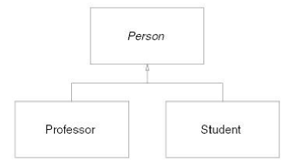
Inheritance
Tips to apply inheritance effectively
Look for similarities (in classes, attributes, methods)
Look for existing classes (when you identify a new class)
Follow the sentence rule ( a subclass is a kind of superclass)
Avoid implementation inheritance
Inherit everything

Slide 13
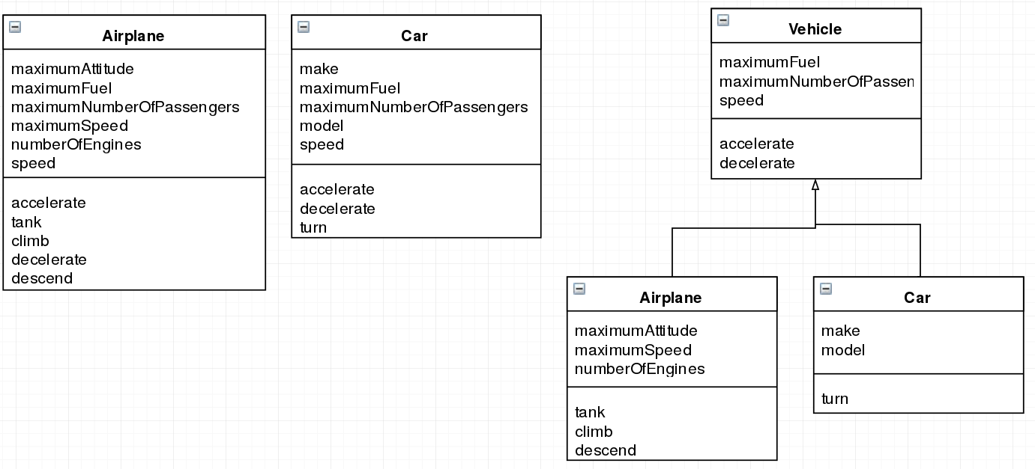
Inheritance

Slide 14
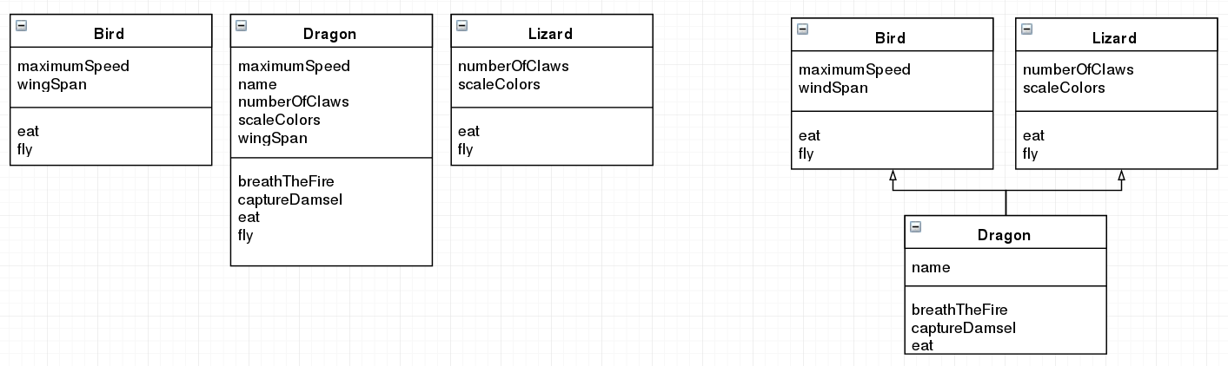
Inheritance

Slide 15
Technical Requirements
Two approaches:
Requiremenst first — then product development.
Product development first — then requirements (reverse engineering, Agile or project management mistake?).
Product Functions development (Functional Requirements)
Requirements development (Technical Requirements)
Product structure development (Code, Hardware)
Architecture

Slide 16
Requirements Artifacts
Artifact | Description
Business rules | A business rule defines or constrains one aspect of your business that is intended to assert business structure or influence the behavior of your business.
Constraints | A constraint is a restriction on the degree of freedom you have in providing a solution. Constraints will supplement other development artifacts, in particular architecture an design-oriented models.
Glossary | A glossary is a collection of definitions that supplements a wide range of development artifacts by defining a common business and technical vocabulary.
Technical requirements | A technical requirement pertrains to the technical aspects that your system must fulfill, such as performance-related, reliability, and availability issues.

Slide 17
Business Rules
BR123 Tenured professors may administer student grades
BR124 Teaching assistants who have been granted authority by a tenured professor may administer student grades
BR177 Table to convert between numeric grades and letter grades (f.e. «A-» to «95%»)
BR245 All master's degree programs must include the development of a thesis

Slide 18
Technical Requirements Organization
General Technical Requirements
General System Technical Requirements
  General Sub-System Technical Requirements
    Component_1 Technical Requirements
    Component_2 Technical Requirements
    ...

Slide 19
HCPP (Hiérarchisation des caractéristiques Produit/Process) Renault Group instrument
The basic idea of HCPP is to rank requirements (because thousands of them) for further interaction with hardware suppliers (OEM).
Basic principles:
Each Technical Requirement has (or has not) Importance Rank: (Important for Safety, Important for Operability, Important for Customer …)
Determine from each requirement, numerical values and admissible deviations of this values — Key Characteristics
Technical Requirement + Rank + Key Characteristics = HCPP Map
HCPP map used during Supplier Nomination process to determine: requirements that supplier can not fulfill — important for Product or not?

Slide 20
HCPP (Hiérarchisation des caractéristiques Produit/Process) Renault Group instrument
Further interaction with hardware suppliers (OEM):
The supplier for each requirement provides a feasibility factor.
On the basis of the feasibility factor and the importance rank, we can estimate the cost of quality control.

Slide 21
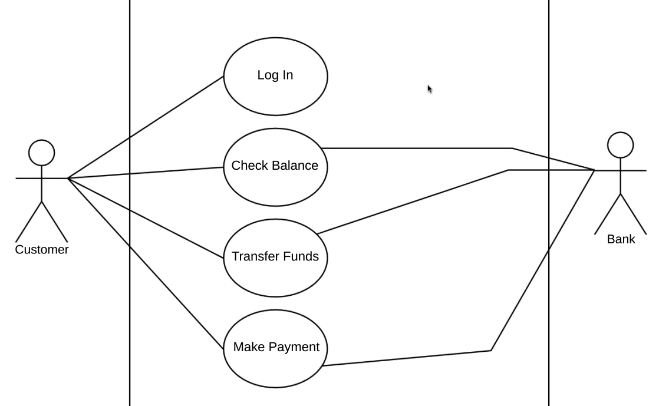
Use Case Diagram Example: Banking App
UML Use Case Diagram Tutorial by Lucidchart https://www.youtube.com/watch?v=zid-MVo7M-E

Slide 22
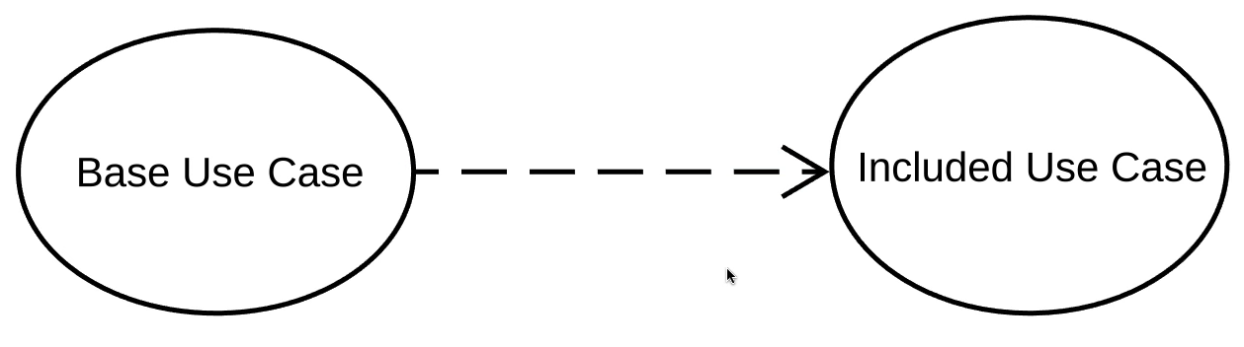
Use Case Diagram: Include relation
If Base Use Case executed then Included Use Case executed
Base Use Case requires Included Use Case to be complete

Slide 23
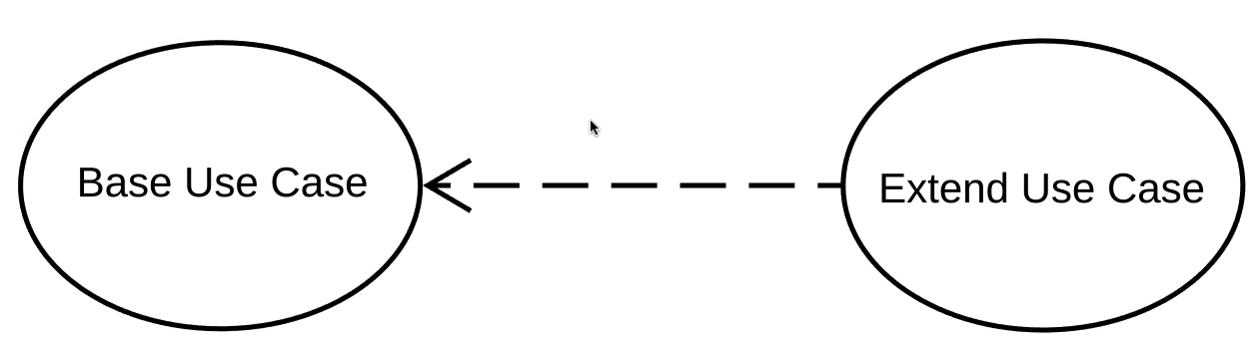
Use Case Diagram: Extend relation
If Base Use Case executed then Exten Use Case executed sometimes, but not everytime

Slide 24
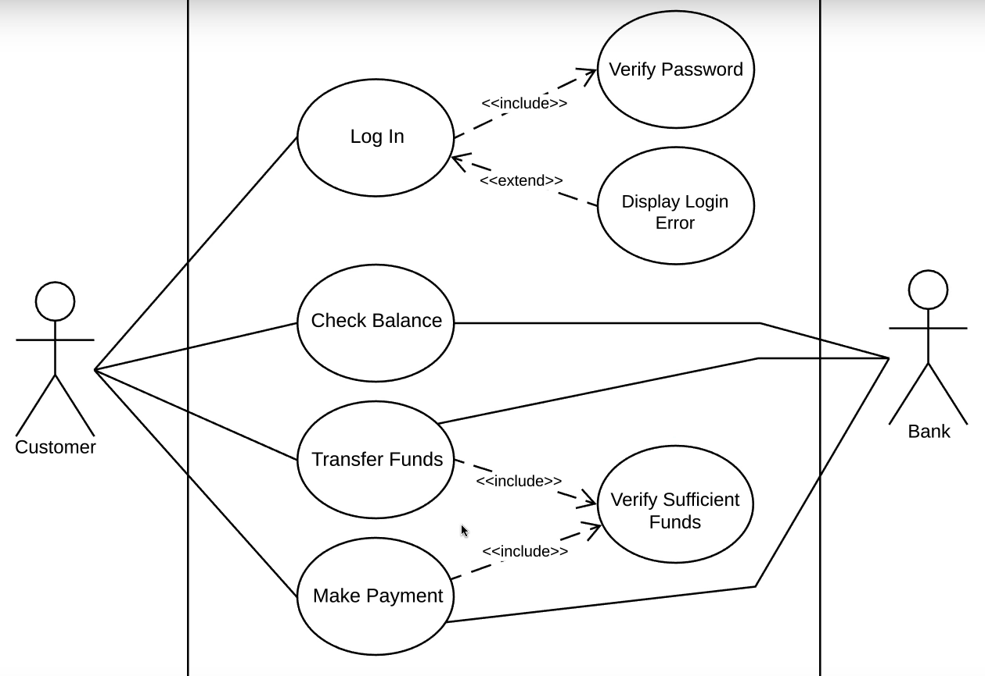
Use Case Diagram Example: Banking App

Slide 25
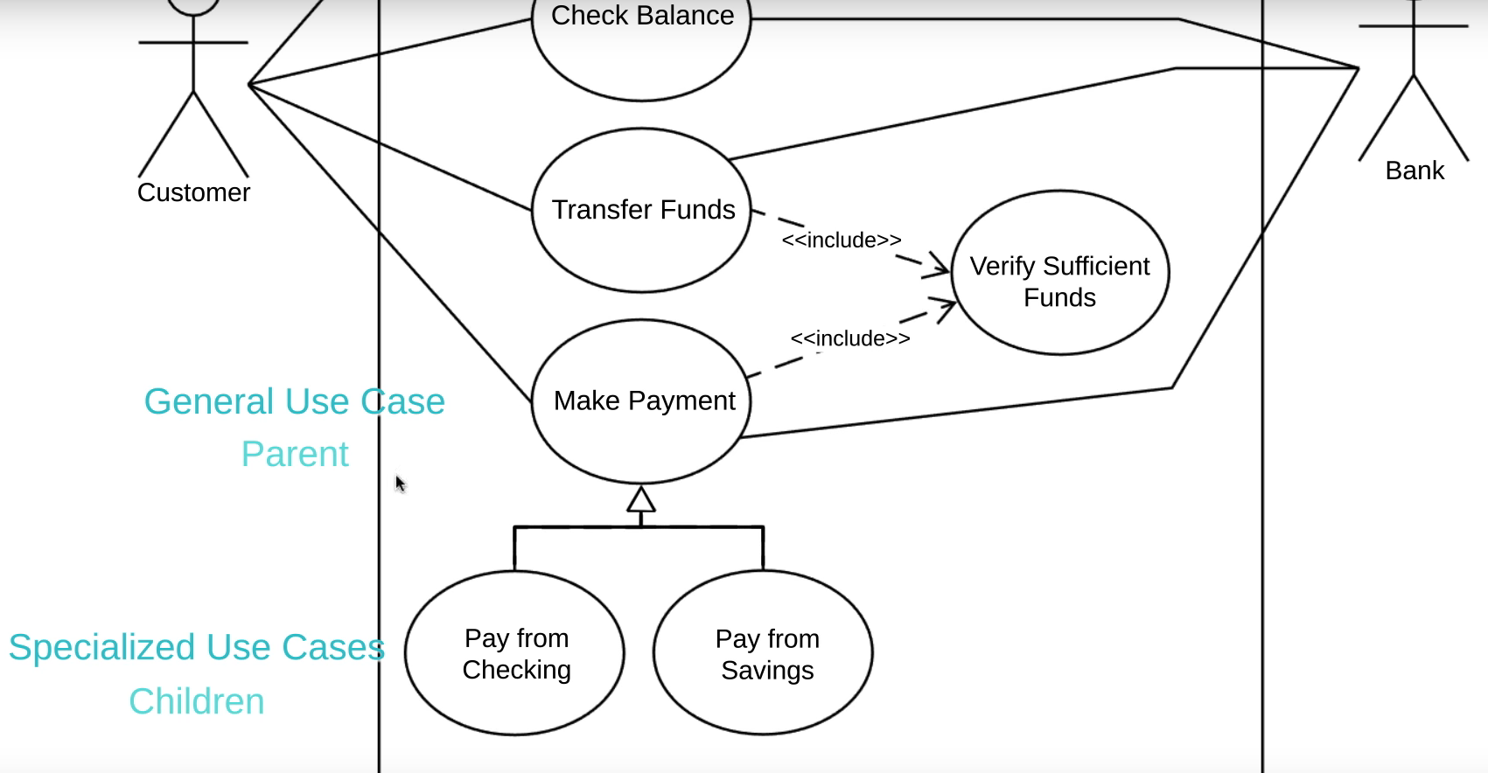
Use Case Diagram: Generalizaion relation

Slide 26
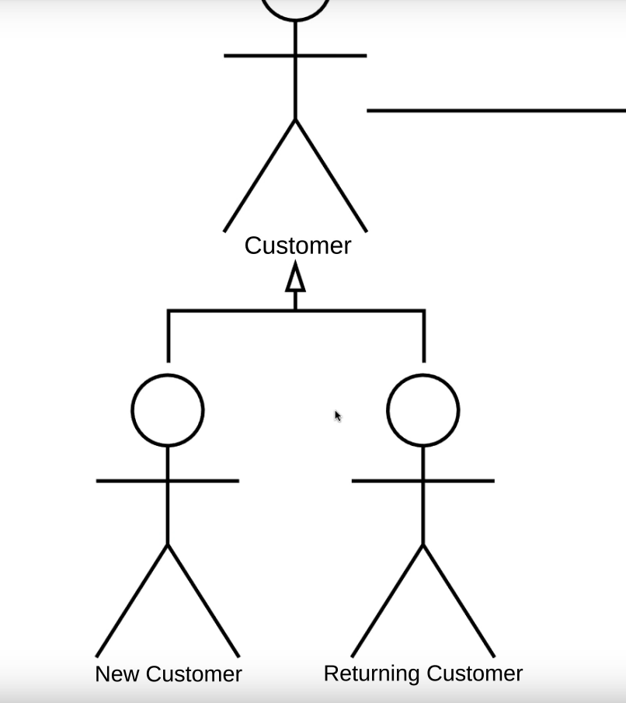
Use Case Diagram: Generalizaion relation

Slide 27
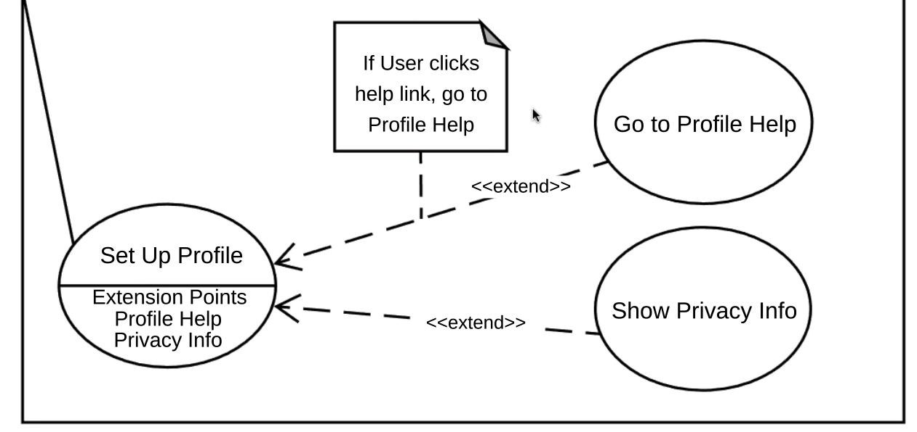
Use Case Diagram: Extension relation

Slide 28
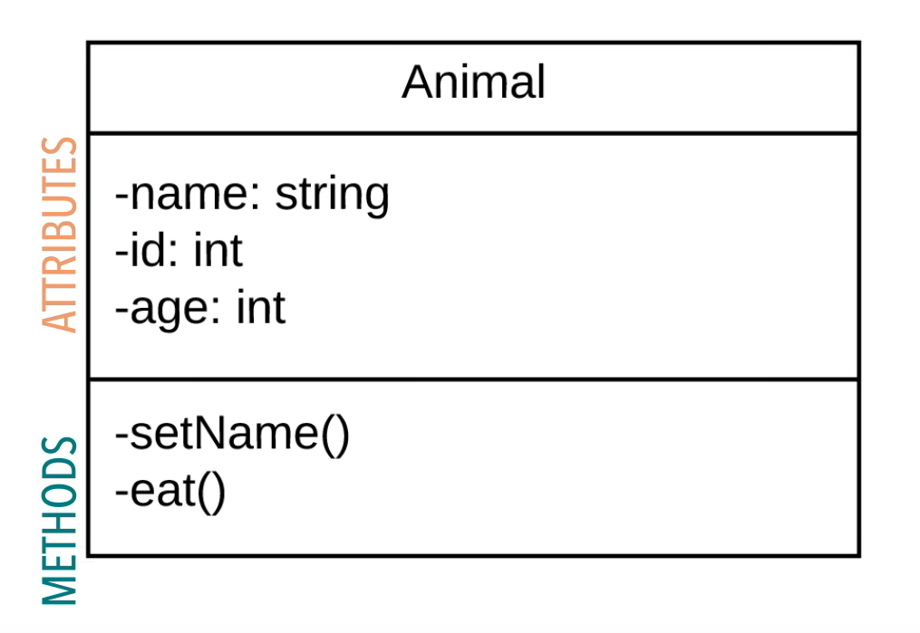
Class Diagram: Class block

Slide 29
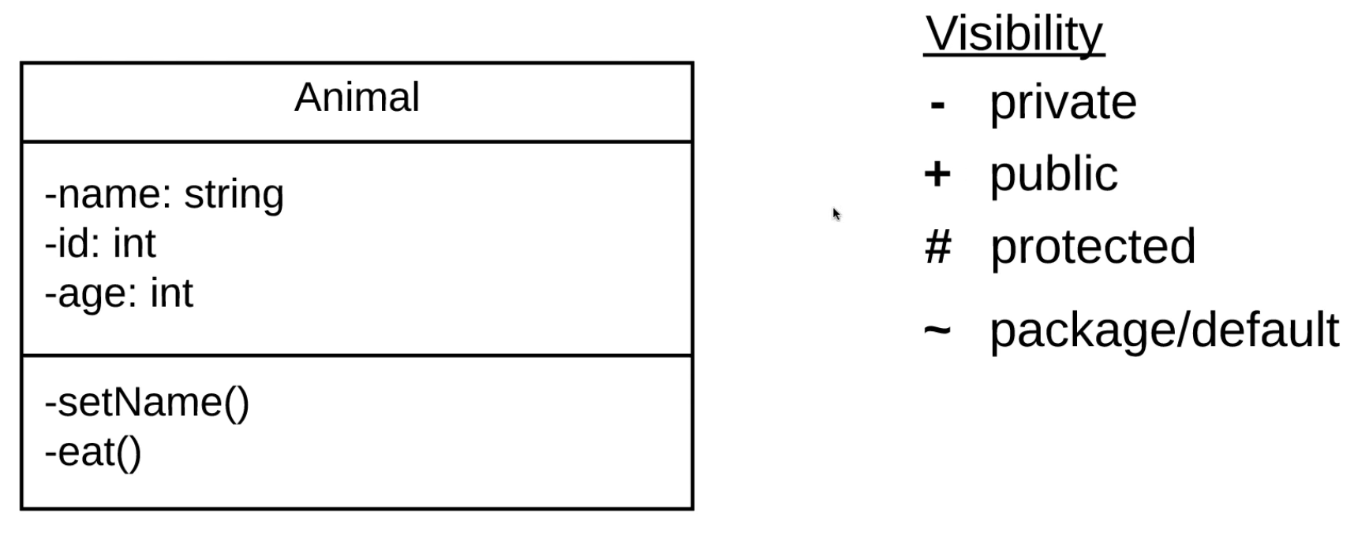
Class Diagram: Class block
private — can note be accessed by any class or sub-class
public — can be accessed by any class or sub-class
protected — can only be accessed by same class or sub-classes
package/default — can be used by any other class in the same package

Slide 30
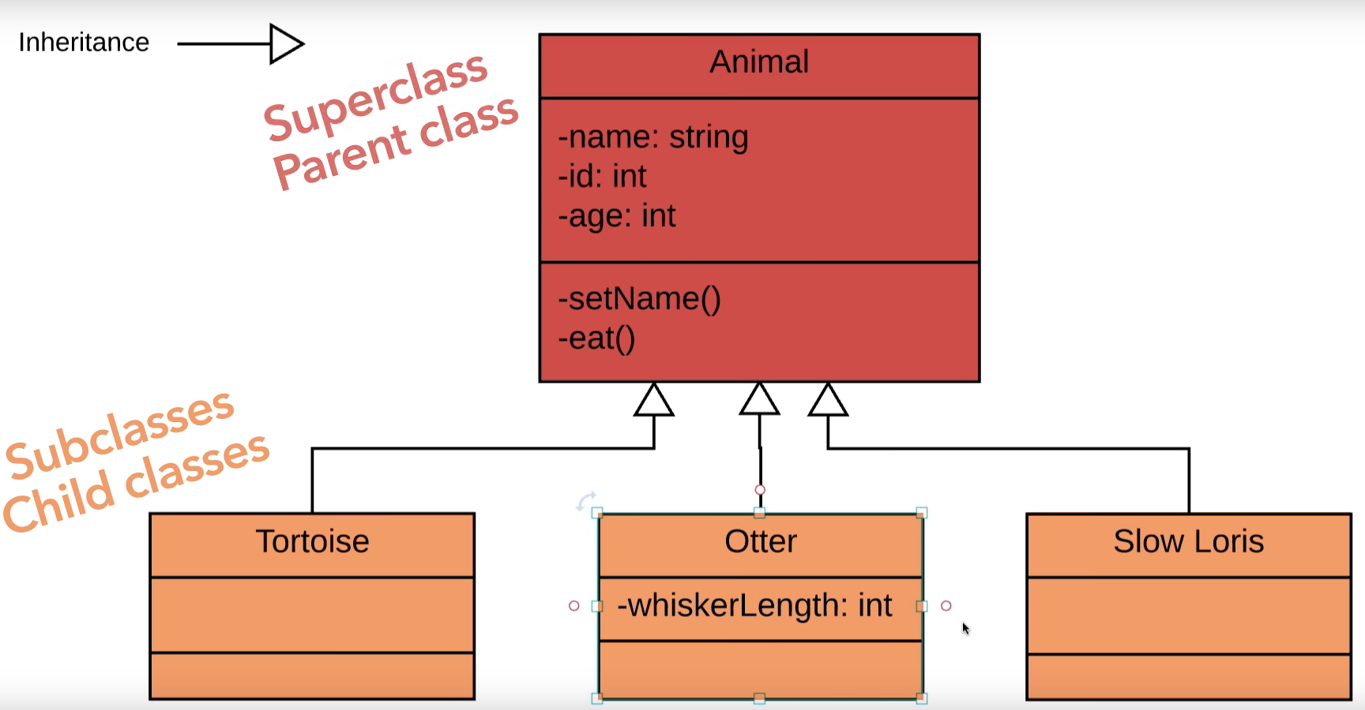
Class Diagram: Inheritance relation

Slide 31
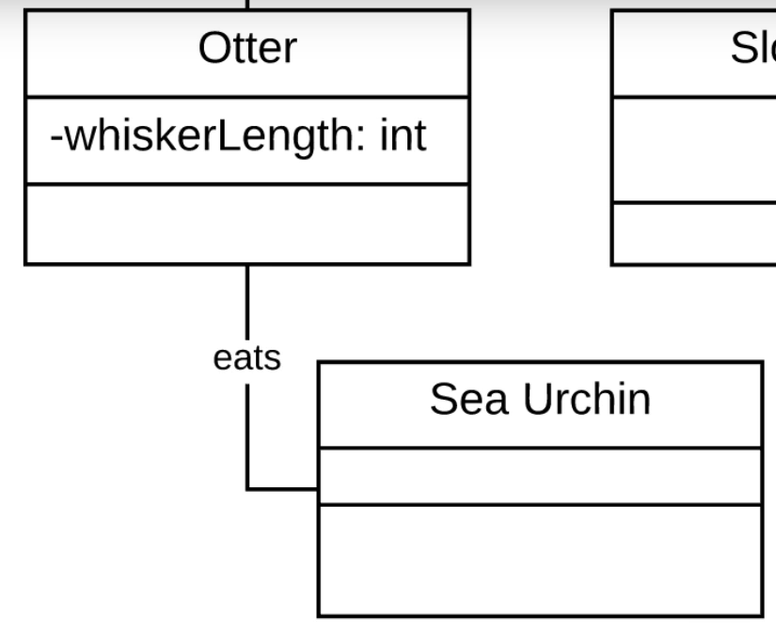
Class Diagram: Association relation

Slide 32
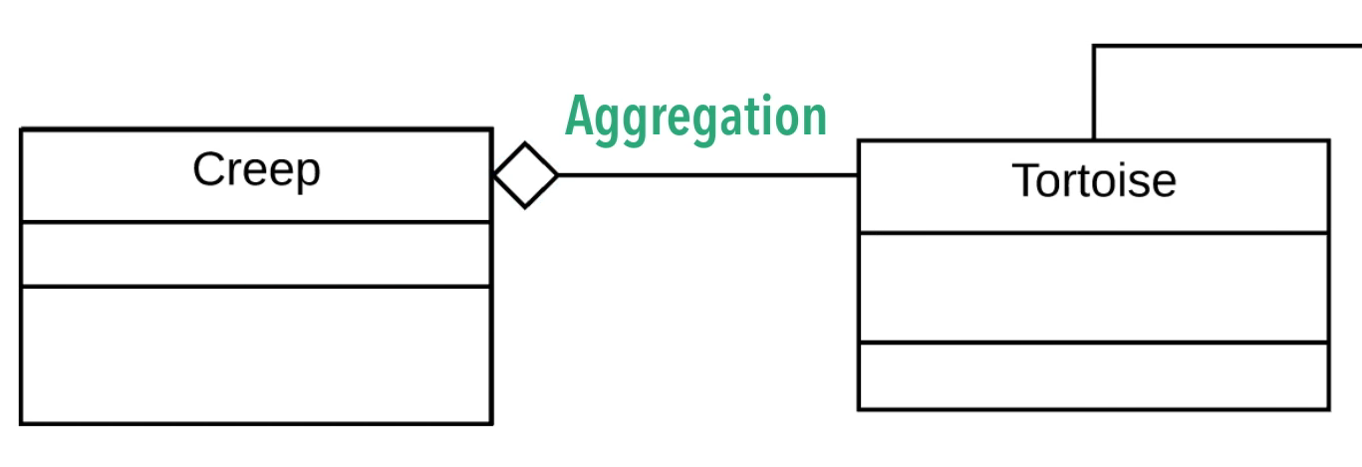
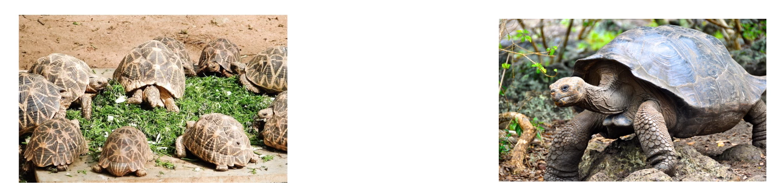
Class Diagram: Aggregation relation

Slide 33
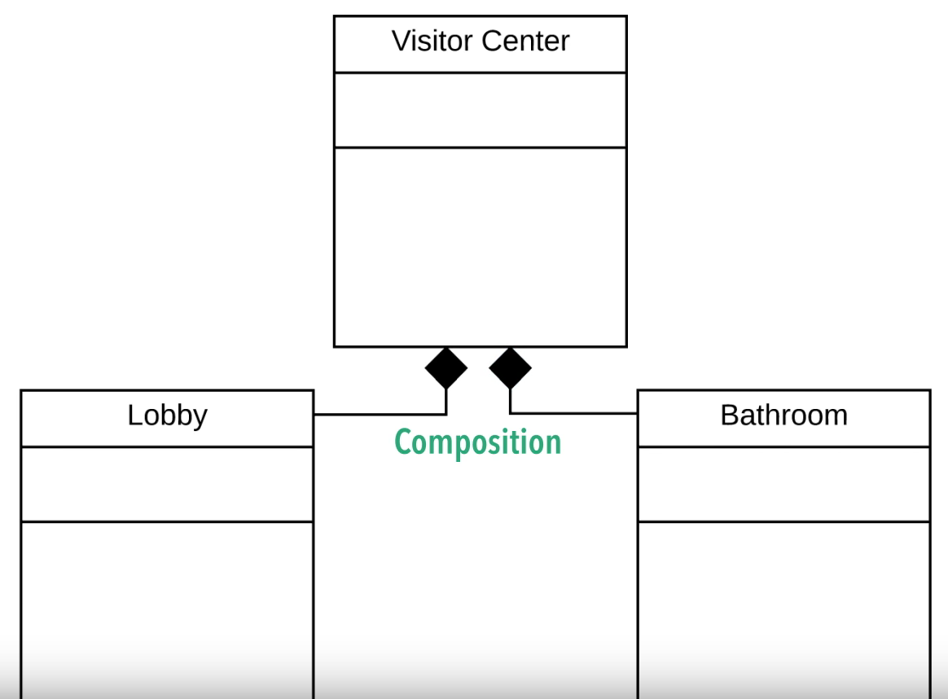
Class Diagram: Composition relation

Slide 34
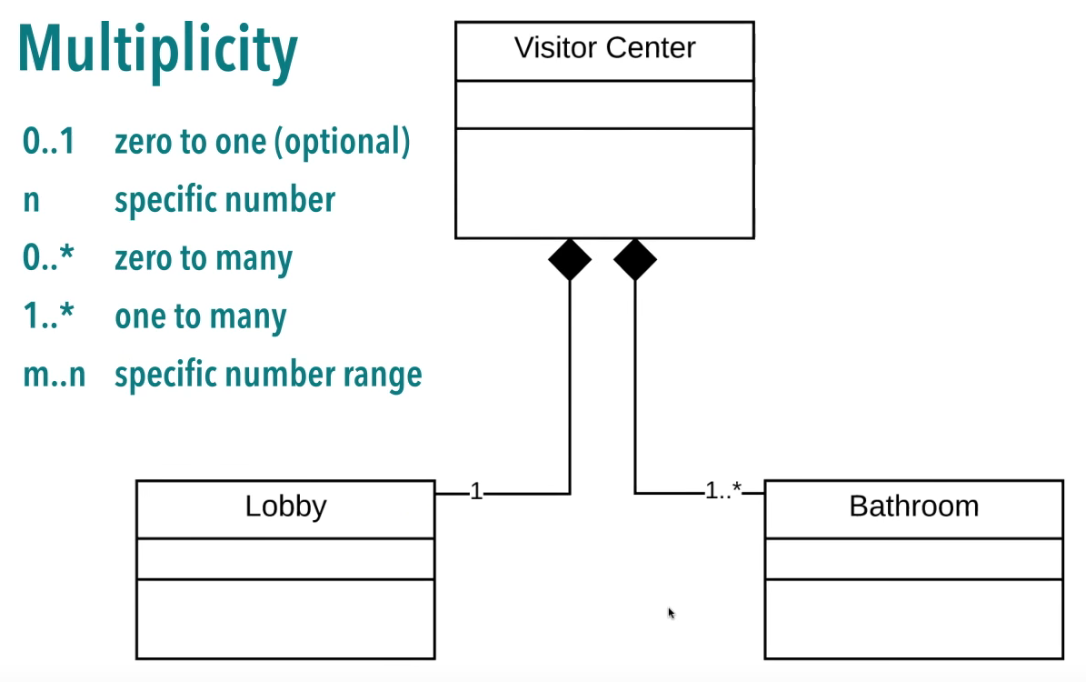
Class Diagram: Multiplicity

Slide 35
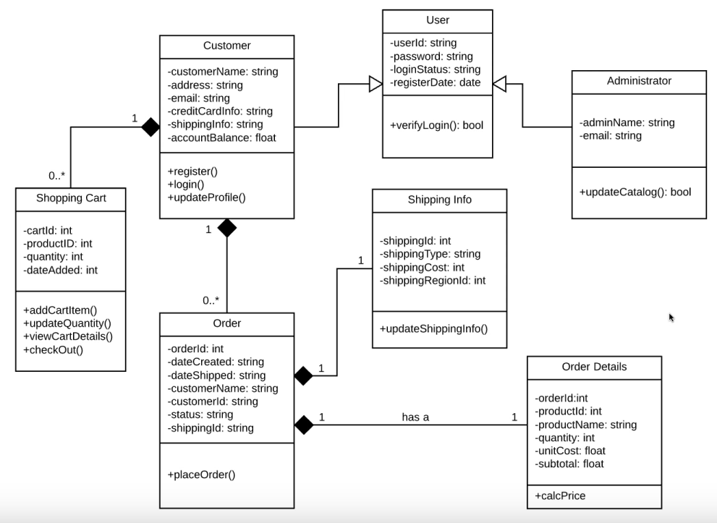
Class Diagram Example: Market

